Slide 1
Lecture 32

Slide 3
Question 123.14.1.5
A car is driving down I-20 at 70mph (the new speed limit). Does the center of mass of the car have the same kinetic energy as a piston in the engine?
Yes
No
Maybe
Wait, the speed limit changed?

Slide 4
Question 123.14.1
We have two gases, each with the same values of n, V and T. One gas is Hydrogen, the other is Nitrogen. For which gas is the rms speed larger?
Hydrogen
Nitrogen

Slide 5
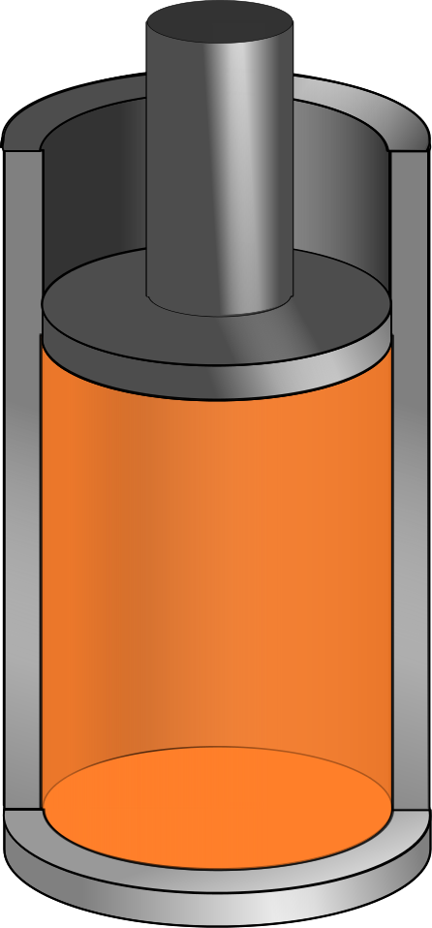
v_{system}
v_{molecule}
V
P
n
T

Slide 7
Assumptions
The number of molecules in the gas is large and the average separation between them is large compared to their dimensions
The molecules obey Newton’s laws of motion, but as a whole they move randomly

Slide 8
Assumptions, cont.
The molecules interact only by short-range forces during elastic collisions
The molecules make elastic collisions with the walls
The gas under consideration is a pure substance, all the molecules are identical

Slide 9
Question 123.14.5
A ball bounces off a wall. If the initial velocity of the ball is v_{x} and the final velocity of the ball is –v_{x}, what is the change in momentum of the ball?
mv_{x}
0
-mv_{x}
-2mv_{x}
v_{x}
-v_{x}

Slide 10
Particle in a Box
d
v
d
v_{x}

Slide 11
Momentum of the Collision
v_{x}
-v_{x}

Slide 12
Question 123.14.5
A ball bounces off a wall. If the initial velocity of the ball is v_{x} and the final velocity of the ball is –v_{x}, what is the change in momentum of the ball?
mv_{x}
0
-mv_{x}
-2mv_{x}
v_{x}
-v_{x}

Slide 13
Question
Suppose we put your feet in a bucket of ice water and your head in a hot oven. How do you feel?
Too hot
Too cold
On average you feel fine

Slide 14
Average Force and Impulse
F
t
F
F
F
t
t
F
t

Slide 15
Question 123.14.7
What is the name of this quantity?
Kale-Gordon factor
Boltzmann's factor
The average value of x
The standard deviation of x

Slide 16
Question 123.14.8
We learned a name for what is that name?
b)
c)
d) Craig

Slide 17
Some rms Speeds

Slide 18
Question 123.15.1
Each degree of freedom contributes how much energy?

Slide 19
Question 123.15.2
In the kinetic theory of gasses, what is temperature?
how much heat you have
the average internal kinetic energy of the gas
the average potential energy of the molecules
the average momentum of the molecules

Slide 20
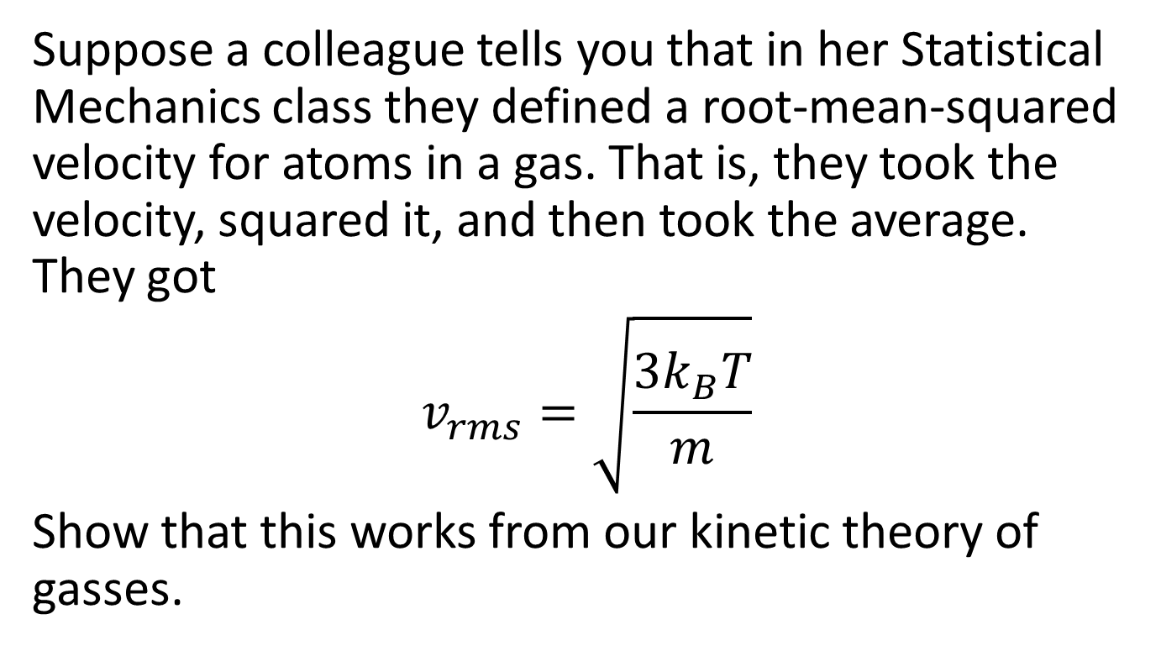
Problem
Suppose a colleague tells you that in her Statistical Mechanics class they defined a root-mean-squared velocity for atoms in a gas. That is, they took the velocity, squared it, and then took the average. They got
$$v_{rms}=\sqrt{\frac{3k_{B}T}{m}}$$
Show that this works from our kinetic theory of gasses.

Slide 21
Question 123.14.4
Two gases have the same number of molecules, the same volume, pressure, and temperature. Gas A has molecules that are twice the size of gas B. The mean path of A is
¼ the mean free path of B
½ the mean free path of B
Twice the mean free path of B
4 times the mean free path of B

Slide 22
Mean Free Path
The average distance between collisions. Depends on:
diameter of the molecules
density of gas
Random-walk process

Slide 23
Equivalent Collision
Collision
Equivalent Collision
d
d
d
d

Slide 24
L
2d

Slide 25
Mean Free Path
Collision Frequency
Random-walk process

Slide 26
Mean Free Path
For air molecules at room temperature:
(Molecule separation distance is 3.4x10⁻⁹ m.)

Slide 27
Partial Summary
Mean Free Path
Problems to try 21.45, 21.61
Extra Credit: Write up why the square root of 2 was needed

Slide 28
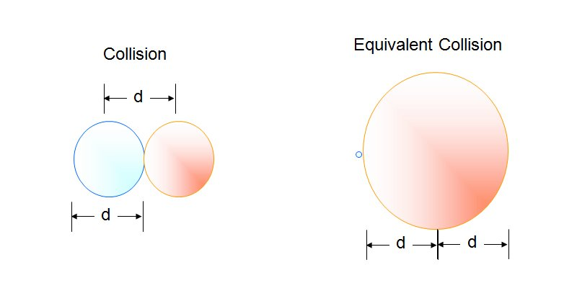

Slide 29
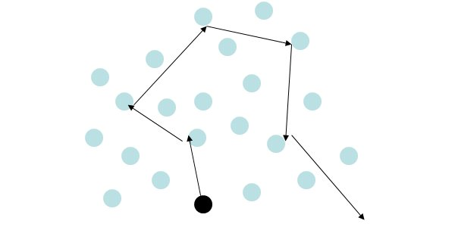

Slide 30
Question 123.15.1
Each degree of freedom contributes how much energy?

Slide 31
Question 123.15.2
In the kinetic theory of gasses, what is temperature?
how much heat you have
the average internal kinetic energy of the gas
the average potential energy of the molecules
the average momentum of the molecules

Slide 32
Question 123.15.3
Two containers hold an ideal gas at the same temperature and pressure. Both containers hold the same type of gas but container B has twice the volume of container A. The average translational kinetic energy per molecule in container B is
Twice that for container A
The same as that for container A
Half that of container A
Can’ Tell

Slide 33
Question 123.15.4
Approximately what is the average velocity of the molecules in this room?
478m/s
1901m/s
101005m/s
0m/s

Slide 34
Diatomic Molecule
z
y
x

Slide 35
Rotational Degrees of Freedom
z
y
x

Slide 36
Vibrational Degrees of Freedom
z
y
x

Slide 37
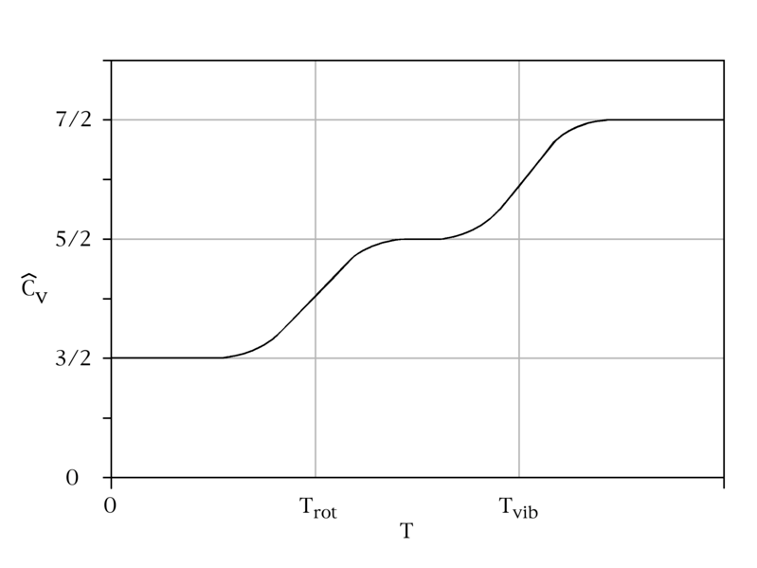
C_{v} vs Temperature

Slide 38
Energy States of a Diatomic Molecule
Available Energy States
Vibrational State
3p
Electronic
State
Roptational State
Increasing Energy
Possible Energy Transitions
2s
Electronic
State

Slide 39
Model of a Solid
z
y
x

Slide 40
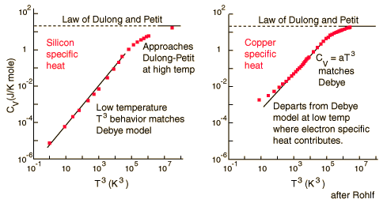
Dulong and Petit Law
http://hyperphysics.phy-astr.gsu.edu/Hbase/thermo/dulong.html

Slide 41
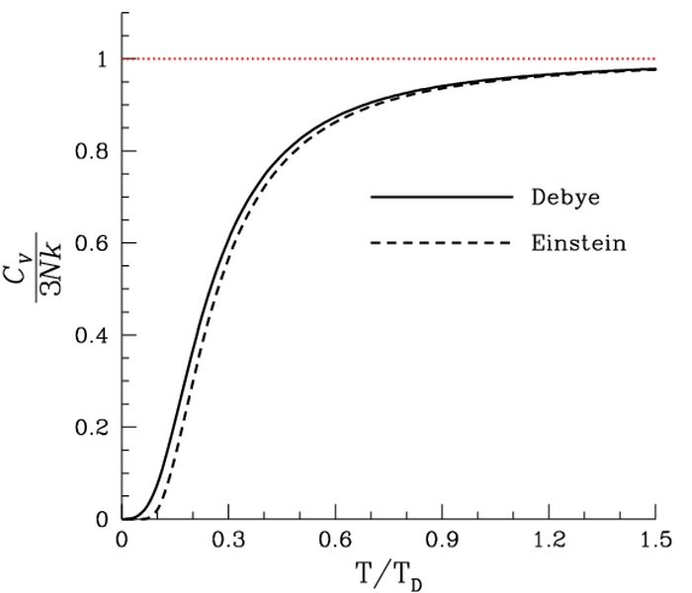

Slide 42
End

Slide 43
Question 123.16.1
What is the microscopic mechanism for energy transfer between two objects in thermal contact?
collisions
Heat moving
Transfer of particles
Radiation

Slide 44
Question 123.16.0.1
Can time go backwards?
Of course, you just make the Enterprise go really fast
No
Yes, but you need to travel in space as well

Slide 45
Question 123.16.0.2
Why does time only go one direction?
Because we are not The Flash and can’t run fast enough
Because the second law of thermodynamics says so
We don’t know

Slide 46
Question 123.16.1
Does disorder always increase in thermodynamic processes?
Yes
No
Maybe (be prepared to explain)

Slide 47
N₁
N₂
T₁
T₂

Slide 51
Question 123.16.2
In thermodynamics, we have several state variables. Combined with the Ideal Gas Law we have ΔE_{in}t, P, V, n, and T. There is one more we are studying, it is
R
ΔS
C_{v}
C_{p}

Slide 52
Probabilities:
Two boxes:
One particle on left: ½
Two particles on left: ¼
50 particles on left: 1/1125899906842624
Two boxes, 100 particles, 50 slowest on one side, 50 fastest on the other
1/1267650600228229401496703205376

Slide 53
Adiabatic Free Expansion Again
V_{i}
Vacuum

Slide 54
Entropy, Molecule Example Extended
Consider 100 molecules in the container
The probability of separating 50 fast molecules on one side and 50 slow molecules on the other side is (½)¹⁰⁰
If we have one mole of gas, this is found to be extremely improbable

Slide 55
Entropy and Heat
The original formulation of entropy dealt with the transfer of energy by heat in a reversible process
Let dQ_{r} be the amount of energy transferred by heat when a system follows a reversible path
The change in entropy, ΔS is

Slide 56
Entropy and Heat, cont
The change in entropy depends only on the endpoints and is independent of the path followed
The entropy change for an irreversible process can be determined by calculating the change in entropy for a reversible process that connects the same initial and final points

Slide 57
More About Change in Entropy
dQ_{r} is measured along a reversible path, even if the system may have followed an irreversible path
The meaningful quantity is the change in entropy and not the entropy itself
For a finite process,

Slide 58
Change in Entropy, cont
The change in entropy of a system going from one state to another has the same value for all paths connecting the two states
The finite change in entropy depends only on the properties of the initial and final equilibrium states

Slide 59
ΔS for a Reversible Cycle
ΔS = 0 for any reversible cycle
In general,
This integral symbol indicates the integral is over a closed path

Slide 60
ΔS for a Quasi-Static, Reversible Process
Assume an ideal gas undergoes a quasi-static, reversible process
Its initial state has T_{i} and V_{i}
Its final state has T_{f} and V_{f}
The change in entropy is
This demonstrates that ΔS depends on only the initial and final states and not the path between the states

Slide 61
Entropy Changes in Irreversible Processes
To calculate the change in entropy in a real system, remember that entropy depends only on the state of the system
Do not use Q, the actual energy transfer in the process
Distinguish this from Q_{r} , the amount of energy that would have been transferred by heat along a reversible path
Q_{r} is the correct value to use for ΔS

Slide 62
Entropy Changes in Irreversible Processes, cont
In general, the total entropy and therefore the total disorder always increases in an irreversible process
The total entropy of an isolated system undergoes a change that cannot decrease
This is another statement of the second law of thermodynamics

Slide 63
Entropy Changes in Irreversible Processes, final
If the process is irreversible, then the total entropy of an isolated system always increases
In a reversible process, the total entropy of an isolated system remains constant
The change in entropy of the Universe must be greater than zero for an irreversible process and equal to zero for a reversible process

Slide 64
Heat Death of the Universe
Ultimately, the entropy of the Universe should reach a maximum value
At this value, the Universe will be in a state of uniform temperature and density
All physical, chemical, and biological processes will cease
The state of perfect disorder implies that no energy is available for doing work
This state is called the heat death of the Universe

Slide 65
ΔS in Thermal Conduction
The cold reservoir absorbs Q and its entropy changes by Q/T_{c}
At the same time, the hot reservoir loses Q and its entropy changes by -Q/T_{h}
Since T_{h} > T_{c} , the increase in entropy in the cold reservoir is greater than the decrease in entropy in the hot reservoir
Therefore, ΔS_{U} > 0
For the system and the Universe

Slide 66
ΔS in a Free Expansion
Consider an adiabatic free expansion
Q = 0 but cannot be used since that is for an irreversible process

Slide 67
ΔS in Free Expansion, cont
For an isothermal process, this becomes
Since V_{f} > V_{i} , ΔS is positive
This indicates that both the entropy and the disorder of the gas increase as a result of the irreversible adiabatic expansion

Slide 68
ΔS in Calorimetric Processes
The process is irreversible because the system goes through a series of non-equilibrium states
Assuming the specific heats remain constant and no mixing takes place:
If mixing takes place, this result applies only to identical substances
ΔS will be positive and the entropy of the Universe increases

Slide 69
Question 22.4
Which two quantities are “state variables” meaning they are path independent?
The change in internal energy and change in entropy
The change in internal energy and work
The change in internal energy and heat
Heat and work
The change in internal energy and mean free path

Slide 70
Question 20.8
By observing a system we find that
ΔE_{int} = 0
What might be the reason for this?
It is isolated
It is cyclic
It is isobaric
Can’t tell

Slide 72
An Opinion on the Second Law of Thermodynamics and Mormon Thought

Slide 73
Warning
This is not an official statement of doctrine
This is an answer to a question that many scientists must face from colleagues who will try to attack their faith using the principals of thermodynamics
Official statements by the General Authorities supersede any opinions expressed here

Slide 74
First Law: Conservation of Energy (and Mass)
And there stood one among them that was like unto God, and he said unto those who were with him: We will go down, for there is space there, and we will take of these materials, and we will make an earth whereon these may dwell; (Abraham 3:24 )
You ask the learned doctors why the say the world was made out of nothing; and they will answer, ‘Doesn’t the Bible say He created the world?’ And they infer, from the word create, that it must have been made out of nothing. Now, the word create came from the word baurau which does not mean create out of nothing; it means to organize; the same as a man would organize materials and build a ship.
Joseph Smith, King Follett Discourse
The idea of the first law of thermodynamics seems in harmony with LDS thought

Slide 75
Second Law
Jacob Describes the conditions called for by the second law
Wherefore, the first judgment which came upon man must needs have remained to an endless duration. And if so, this flesh must have laid down to rot and to crumble to its mother earth, to rise no more. (2 Nephi 9:7)
And our spirits must have become like unto [Satain], and we become devils, angels to a devil, to be shut out from the presence of our God, and to remain with the father of lies, in misery, like unto himself. (2 Nephi 9:9)
We also seem to accept the concept of the second law as well
--This will be a surprise to our non-Mormon friends

Slide 76
Does Something Counter the Second Law (a Third Law of Thermodynamics)?
Jacob describes another force not recognized by current scientific theory that counteracts this tendency to decay
Wherefore, it must needs be an infinite atonement—save it should be an infinite atonement this corruption could not put on incorruption. Wherefore, the first judgment which came upon man must needs have remained to an endless duration. And if so, this flesh must have laid down to rot and to crumble to its mother earth, to rise no more. (2 Nephi 9:7-8)
O how great the goodness of our God, who prepareth a way for our escape from the grasp of this awful monster; yea, that monster, death and hell, which I call the death of the body, and also the death of the spirit. (2 Nephi 9:10)
Atonement means to bring together. This is an apt description of a process or law that would counter or balance the second law
(Nibley, The meaning of the temple, reprinted in the Collected Works of Hugh Nibley: volume 12, Deseret Book, Salt Lake City, UT, 1992)
Since the atonement can only be accessed through Christ, it is not likely to be discovered in a laboratory, but is a very real, physical, process. (see for example Luke 24:39)

Slide 77
Entropy, Marble Example
Suppose you have a bag with 50 red marbles and 50 green marbles
You draw a marble, record its color, return it to the bag, and draw another
Continue until four marbles have been drawn
What are possible macrostates and what are their probabilities?

Slide 78
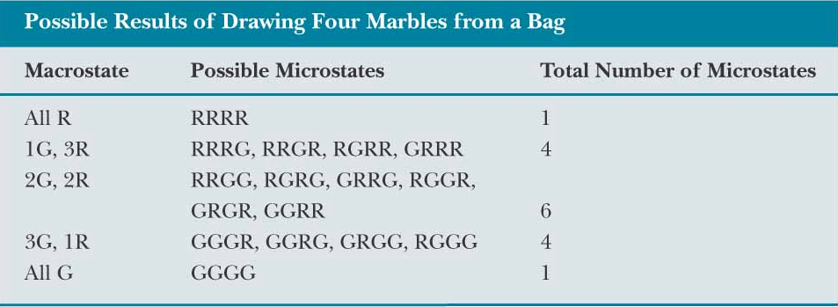
Entropy, Marble Example, Results
The most ordered are the least likely
The most disorder is the most likely

Slide 79
Summary
Two forms of entropy equations
Microscopic
Cyclic Reversible Process
Problems to now try 9-13

Slide 80
Question 123.14.2
If the temperature increases, the peak of the Maxwell-Boltzmann speed distribution
Increases to a higher velocity
Decreases to a lower velocity
Stays the same
Can’t tell

Slide 81
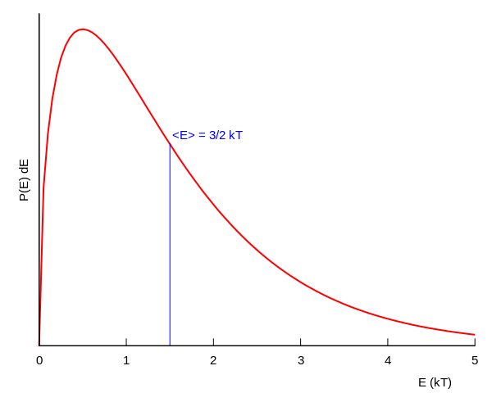
Boltzmann Distribution

Slide 82
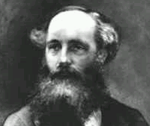
Found an expression for the Molecular Speed Distribution
James Clerk Maxwell (1831-1879)

Slide 83
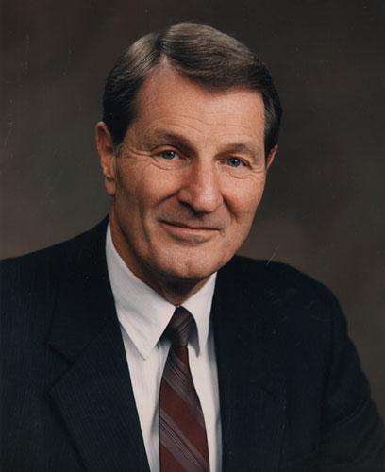
Not the same guy
Neal A. Maxwell
(1926-2004)

Slide 84
N - total number of molecules

Slide 85
Question 123.14.2
If the temperature increases, the peak of the Maxwell-Boltzmann speed distribution
Increases to a higher velocity
Decreases to a lower velocity
Stays the same
Can’t tell

Slide 86
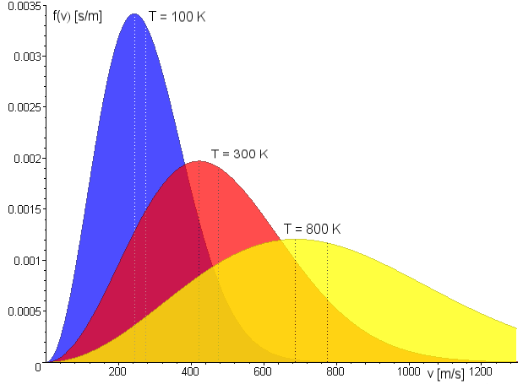
Maxwell Distribution
A system of gas at a given temperature will exhibit a variety of speeds
Three speeds are of interest:
Most probable
Average
rms
Image in the Public Domain couracy Fred Stober

Slide 87
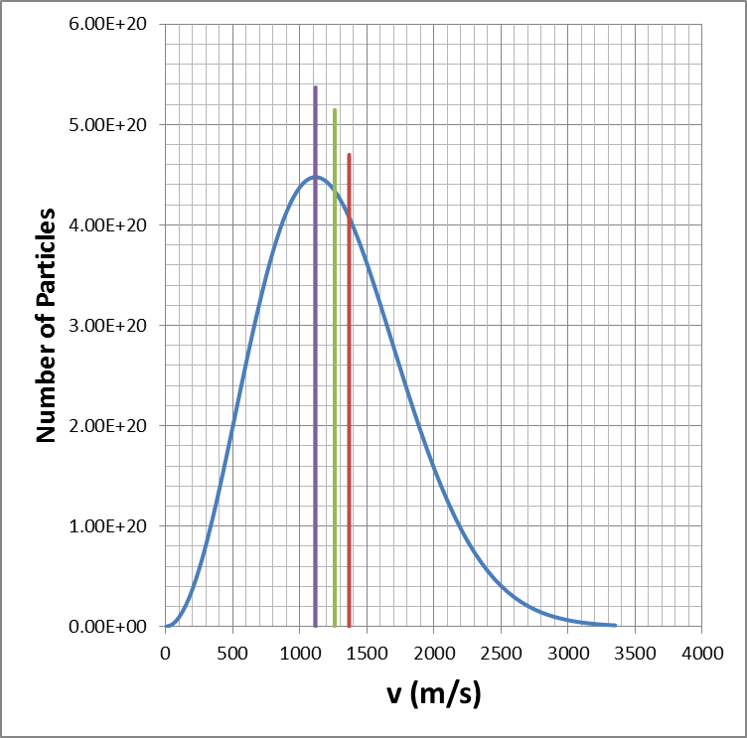
Molecular Speeds

Slide 88
Question 123.14.4
Two gases have the same number of molecules, the same volume, pressure, and temperature. Gas A has molecules that are twice the size of gas B. The mean path of A is
¼ the mean free path of B
½ the mean free path of B
Twice the mean free path of B
4 times the mean free path of B

Slide 89
Mean Free Path
The average distance between collisions. Depends on:
diameter of the molecules
density of gas
Random-walk process

Slide 90
Equivalent Collision
Collision
Equivalent Collision
d
d
d
d

Slide 91
L
2d

Slide 92
Mean Free Path
Collision Frequency
Random-walk process

Slide 93
Mean Free Path
For air molecules at room temperature:
(Molecule separation distance is 3.4x10⁻⁹ m.)

Slide 94
Partial Summary
Mean Free Path
Problems to try 21.45, 21.61
Extra Credit: Write up why the square root of 2 was needed

Slide 97
Question 123.15.1
Each degree of freedom contributes how much energy?

Slide 98
Question 123.15.2
In the kinetic theory of gasses, what is temperature?
how much heat you have
the average internal kinetic energy of the gas
the average potential energy of the molecules
the average momentum of the molecules

Slide 99
Question 123.15.3
Two containers hold an ideal gas at the same temperature and pressure. Both containers hold the same type of gas but container B has twice the volume of container A. The average translational kinetic energy per molecule in container B is
Twice that for container A
The same as that for container A
Half that of container A
Can’ Tell

Slide 100
Question 123.15.4
Approximately what is the average velocity of the molecules in this room?
478m/s
1901m/s
101005m/s
0m/s

Slide 101
Diatomic Molecule
z
y
x

Slide 102
Rotational Degrees of Freedom
z
y
x

Slide 103
Vibrational Degrees of Freedom
z
y
x

Slide 104
C_{v} vs Temperature

Slide 105
Energy States of a Diatomic Molecule
Available Energy States
Vibrational State
3p
Electronic
State
Roptational State
Increasing Energy
Possible Energy Transitions
2s
Electronic
State

Slide 106
Model of a Solid
z
y
x

Slide 107
Dulong and Petit Law
http://hyperphysics.phy-astr.gsu.edu/Hbase/thermo/dulong.html

Slide 109
End

Slide 110
Question 123.16.1
What is the microscopic mechanism for energy transfer between two objects in thermal contact?
collisions
Heat moving
Transfer of particles
Radiation

Slide 111
Question 123.16.0.1
Can time go backwards?
Of course, you just make the Enterprise go really fast
No
Yes, but you need to travel in space as well

Slide 112
Question 123.16.0.2
Why does time only go one direction?
Because we are not The Flash and can’t run fast enough
Because the second law of thermodynamics says so
We don’t know

Slide 113
Question 123.16.1
Does disorder always increase in thermodynamic processes?
Yes
No
Maybe (be prepared to explain)

Slide 114
N₁
N₂
T₁
T₂

Slide 118
Question 123.16.2
In thermodynamics, we have several state variables. Combined with the Ideal Gas Law we have ΔE_{in}t, P, V, n, and T. There is one more we are studying, it is
R
ΔS
C_{v}
C_{p}

Slide 119
Probabilities:
Two boxes:
One particle on left: ½
Two particles on left: ¼
50 particles on left: 1/1125899906842624
Two boxes, 100 particles, 50 slowest on one side, 50 fastest on the other
1/1267650600228229401496703205376

Slide 120
Adiabatic Free Expansion Again
V_{i}
Vacuum

Slide 121
Entropy, Molecule Example Extended
Consider 100 molecules in the container
The probability of separating 50 fast molecules on one side and 50 slow molecules on the other side is (½)¹⁰⁰
If we have one mole of gas, this is found to be extremely improbable

Slide 122
Entropy and Heat
The original formulation of entropy dealt with the transfer of energy by heat in a reversible process
Let dQ_{r} be the amount of energy transferred by heat when a system follows a reversible path
The change in entropy, ΔS is

Slide 123
Entropy and Heat, cont
The change in entropy depends only on the endpoints and is independent of the path followed
The entropy change for an irreversible process can be determined by calculating the change in entropy for a reversible process that connects the same initial and final points

Slide 124
More About Change in Entropy
dQ_{r} is measured along a reversible path, even if the system may have followed an irreversible path
The meaningful quantity is the change in entropy and not the entropy itself
For a finite process,

Slide 125
Change in Entropy, cont
The change in entropy of a system going from one state to another has the same value for all paths connecting the two states
The finite change in entropy depends only on the properties of the initial and final equilibrium states

Slide 126
ΔS for a Reversible Cycle
ΔS = 0 for any reversible cycle
In general,
This integral symbol indicates the integral is over a closed path

Slide 127
ΔS for a Quasi-Static, Reversible Process
Assume an ideal gas undergoes a quasi-static, reversible process
Its initial state has T_{i} and V_{i}
Its final state has T_{f} and V_{f}
The change in entropy is
This demonstrates that ΔS depends on only the initial and final states and not the path between the states

Slide 128
Entropy Changes in Irreversible Processes
To calculate the change in entropy in a real system, remember that entropy depends only on the state of the system
Do not use Q, the actual energy transfer in the process
Distinguish this from Q_{r} , the amount of energy that would have been transferred by heat along a reversible path
Q_{r} is the correct value to use for ΔS

Slide 129
Entropy Changes in Irreversible Processes, cont
In general, the total entropy and therefore the total disorder always increases in an irreversible process
The total entropy of an isolated system undergoes a change that cannot decrease
This is another statement of the second law of thermodynamics

Slide 130
Entropy Changes in Irreversible Processes, final
If the process is irreversible, then the total entropy of an isolated system always increases
In a reversible process, the total entropy of an isolated system remains constant
The change in entropy of the Universe must be greater than zero for an irreversible process and equal to zero for a reversible process

Slide 131
Heat Death of the Universe
Ultimately, the entropy of the Universe should reach a maximum value
At this value, the Universe will be in a state of uniform temperature and density
All physical, chemical, and biological processes will cease
The state of perfect disorder implies that no energy is available for doing work
This state is called the heat death of the Universe

Slide 132
ΔS in Thermal Conduction
The cold reservoir absorbs Q and its entropy changes by Q/T_{c}
At the same time, the hot reservoir loses Q and its entropy changes by -Q/T_{h}
Since T_{h} > T_{c} , the increase in entropy in the cold reservoir is greater than the decrease in entropy in the hot reservoir
Therefore, ΔS_{U} > 0
For the system and the Universe

Slide 133
ΔS in a Free Expansion
Consider an adiabatic free expansion
Q = 0 but cannot be used since that is for an irreversible process

Slide 134
ΔS in Free Expansion, cont
For an isothermal process, this becomes
Since V_{f} > V_{i} , ΔS is positive
This indicates that both the entropy and the disorder of the gas increase as a result of the irreversible adiabatic expansion

Slide 135
ΔS in Calorimetric Processes
The process is irreversible because the system goes through a series of non-equilibrium states
Assuming the specific heats remain constant and no mixing takes place:
If mixing takes place, this result applies only to identical substances
ΔS will be positive and the entropy of the Universe increases

Slide 136
Question 22.4
Which two quantities are “state variables” meaning they are path independent?
The change in internal energy and change in entropy
The change in internal energy and work
The change in internal energy and heat
Heat and work
The change in internal energy and mean free path

Slide 137
Question 20.8
By observing a system we find that
ΔE_{int} = 0
What might be the reason for this?
It is isolated
It is cyclic
It is isobaric
Can’t tell

Slide 139
An Opinion on the Second Law of Thermodynamics and Mormon Thought

Slide 140
Warning
This is not an official statement of doctrine
This is an answer to a question that many scientists must face from colleagues who will try to attack their faith using the principals of thermodynamics
Official statements by the General Authorities supersede any opinions expressed here

Slide 141
First Law: Conservation of Energy (and Mass)
And there stood one among them that was like unto God, and he said unto those who were with him: We will go down, for there is space there, and we will take of these materials, and we will make an earth whereon these may dwell; (Abraham 3:24 )
You ask the learned doctors why the say the world was made out of nothing; and they will answer, ‘Doesn’t the Bible say He created the world?’ And they infer, from the word create, that it must have been made out of nothing. Now, the word create came from the word baurau which does not mean create out of nothing; it means to organize; the same as a man would organize materials and build a ship.
Joseph Smith, King Follett Discourse
The idea of the first law of thermodynamics seems in harmony with LDS thought

Slide 142
Second Law
Jacob Describes the conditions called for by the second law
Wherefore, the first judgment which came upon man must needs have remained to an endless duration. And if so, this flesh must have laid down to rot and to crumble to its mother earth, to rise no more. (2 Nephi 9:7)
And our spirits must have become like unto [Satain], and we become devils, angels to a devil, to be shut out from the presence of our God, and to remain with the father of lies, in misery, like unto himself. (2 Nephi 9:9)
We also seem to accept the concept of the second law as well
--This will be a surprise to our non-Mormon friends

Slide 143
Does Something Counter the Second Law (a Third Law of Thermodynamics)?
Jacob describes another force not recognized by current scientific theory that counteracts this tendency to decay
Wherefore, it must needs be an infinite atonement—save it should be an infinite atonement this corruption could not put on incorruption. Wherefore, the first judgment which came upon man must needs have remained to an endless duration. And if so, this flesh must have laid down to rot and to crumble to its mother earth, to rise no more. (2 Nephi 9:7-8)
O how great the goodness of our God, who prepareth a way for our escape from the grasp of this awful monster; yea, that monster, death and hell, which I call the death of the body, and also the death of the spirit. (2 Nephi 9:10)
Atonement means to bring together. This is an apt description of a process or law that would counter or balance the second law
(Nibley, The meaning of the temple, reprinted in the Collected Works of Hugh Nibley: volume 12, Deseret Book, Salt Lake City, UT, 1992)
Since the atonement can only be accessed through Christ, it is not likely to be discovered in a laboratory, but is a very real, physical, process. (see for example Luke 24:39)

Slide 144
Entropy, Marble Example
Suppose you have a bag with 50 red marbles and 50 green marbles
You draw a marble, record its color, return it to the bag, and draw another
Continue until four marbles have been drawn
What are possible macrostates and what are their probabilities?

Slide 145
Entropy, Marble Example, Results
The most ordered are the least likely
The most disorder is the most likely

Slide 146
Summary
Two forms of entropy equations
Microscopic
Cyclic Reversible Process
Problems to now try 9-13

Slide 147
Question 123.14.2
If the temperature increases, the peak of the Maxwell-Boltzmann speed distribution
Increases to a higher velocity
Decreases to a lower velocity
Stays the same
Can’t tell

Slide 148
Boltzmann Distribution

Slide 149
Found an expression for the Molecular Speed Distribution
James Clerk Maxwell (1831-1879)

Slide 150
Not the same guy
Neal A. Maxwell
(1926-2004)

Slide 151
N - total number of molecules

Slide 152
Question 123.14.2
If the temperature increases, the peak of the Maxwell-Boltzmann speed distribution
Increases to a higher velocity
Decreases to a lower velocity
Stays the same
Can’t tell

Slide 153
Maxwell Distribution
A system of gas at a given temperature will exhibit a variety of speeds
Three speeds are of interest:
Most probable
Average
rms
Image in the Public Domain couracy Fred Stober

Slide 154
Molecular Speeds

Slide 155
Question 123.14.4
Two gases have the same number of molecules, the same volume, pressure, and temperature. Gas A has molecules that are twice the size of gas B. The mean path of A is
¼ the mean free path of B
½ the mean free path of B
Twice the mean free path of B
4 times the mean free path of B

Slide 156
Mean Free Path
The average distance between collisions. Depends on:
diameter of the molecules
density of gas
Random-walk process

Slide 157
Equivalent Collision
Collision
Equivalent Collision
d
d
d
d

Slide 158
L
2d

Slide 159
Mean Free Path
Collision Frequency
Random-walk process

Slide 160
Mean Free Path
For air molecules at room temperature:
(Molecule separation distance is 3.4x10⁻⁹ m.)

Slide 161
Partial Summary
Mean Free Path
Problems to try 21.45, 21.61
Extra Credit: Write up why the square root of 2 was needed

